Slide 1
SMART Home
Group 2:
John Satterla [Team Lead] – Computer Engineer – Wireless Connectivity
Zachary Eakerns – Electrical Engineer – Biomedical Station
Zarka McClung – Computer Engineer – Facial Recognition
Christian Jensen – Electrical Engineer – Voice Recognition

Slide 2

Last Week's Deliverables
John Satterla
Zachary Eakerns
Zarka McClung
Christian Jensen
Built and begin testing filters
Begin writing and testing software for peak detection
Research Algorithm and try to implement it
Completed webcam code to test Algorithm with face detection code
Design and order parts for relay circuit
Research Raspberry Pi Smart home front ends
Test ToF Launchpads for accuracy depending on environment
Develop Zigbee network protocol for sending and receiving meaningful data

Slide 3



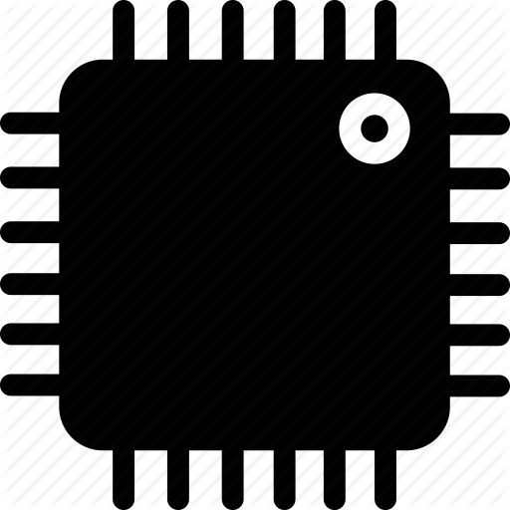






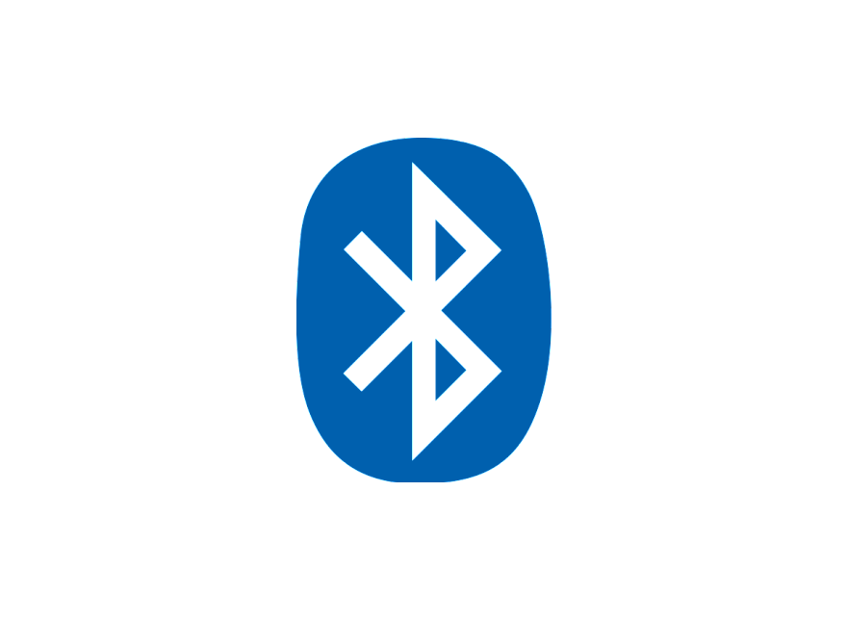


System Overview
Door can be opened automatically via facial recognition or control from central processing station via Zigbee
LEDs to represent Lights
LCD screen represents TV
Biomedical station gets EKG, heart rate, and blood oxygenation of the user, relays information to the Central processing station. Zigbee module takes commands from central processing station to control devices
Biomedical Station
Full size automatic door with facial recognition
Servo based washer representation
Small Scale House Model
Computer fan to represent ceiling fan
Portable BLE Time of Flight device reacts to movements of user throughout the room and devices turn on inside the small scale model
Portable Location Detection Device
Central processing station (computer) displays system information and can control devices via voice commands. Communicates with rest of devices via Zigbee
Bluetooth ToF Beacon
Zigbee Module
Central processing Station, with Voice Recognition
Microcontroller
John Satterla

Slide 4
Tracking Location of the Patient Monitor
Ideally work indoors, so using GPS not preferred because of accuracy and not able to get fix inside of buildings
BLE ToF – Bluetooth Time of Flight
Time of Flight is used to estimate range by measuring the round trip delay of an RF packet exchange
At least two devices needed, and operate generally as a master and a slave, where the master calculates average round trip delay for hundreds of packets to be as accurate as possible (try to reduce error from interference, other RF related differences) [ref]
John Satterla

Slide 5
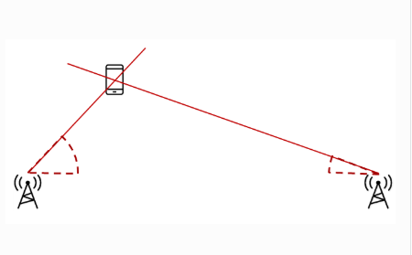
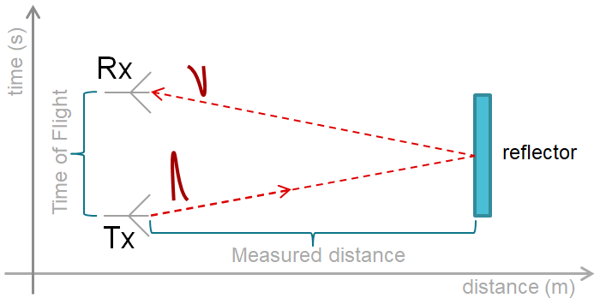
Bluetooth Time of Flight
Experimental Bluetooth Time of Flight stack from Texas Instruments allows patients location to be tracked by calculating the round-trip time and RSSI of packets from the ToF initiator and responder
ToF Responder
ToF Initiator
[1]
John Satterla

Slide 6
BLE ToF – Further Testing
Testing was done to see if interference was cause of problem with location returning negative values
Testing was to no success after testing in environment with limited 2.4GHz interference, although it did seem better than basement lab
In contact with TI on how to improve performance, was directed to some optimization tools in the software that will be tested this week
John Satterla

Slide 7
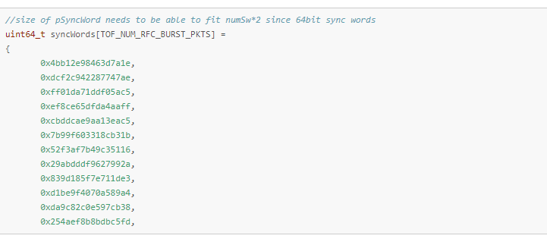
BLE ToF – Further Testing
[2]
Going to try and increase the number of syncwords, which serve as almost ‘ACKs’ that sync each ToF flight packet with each other
John Satterla

Slide 8
Changing Software
Using Code Composer Studio in conjunction with launchpad is far too slow to accurately graph data every 2 ms for EKG readings
To fix this, research into using Python along with UART communication via BlueSMiRF is underway
Microcontroller will still be coded in Code Composer Studio, however receiving data and graphing it will be done through Python

Slide 9
Python
Data can be graphed quickly in Python by using the matplotlib library
Python will store the data received by the BlueSMiRF [1] into a vector and then graph the value
Things to be mindful of include making sure baud rate of both the communication method and the microcontroller are sufficient, and that vector can delete past values incase the machine is left on for a long amount of time

Slide 10
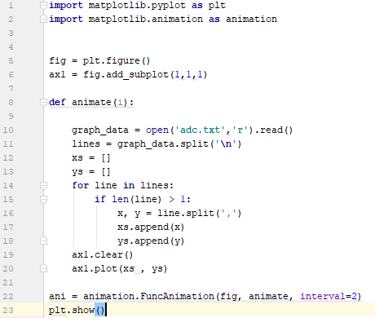

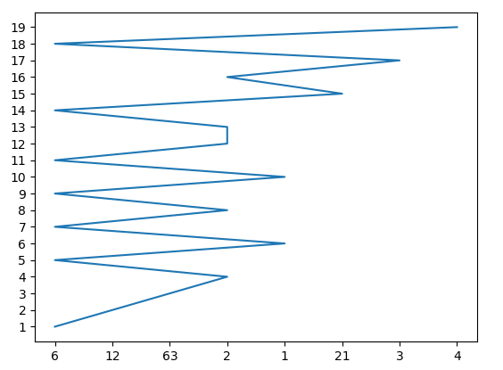
Matplotlib

Slide 11
Instability In Circuitry
While amplification circuit seems to work, as well as the filters removing transmission line noise, the output is unstable at lower frequencies, varying by as much as 20%
Could be due to breadboard, faulty parts, or faulty measuring equipment
Further work will go into identifying issue once code catches up since switching to Python created a setback

Slide 12
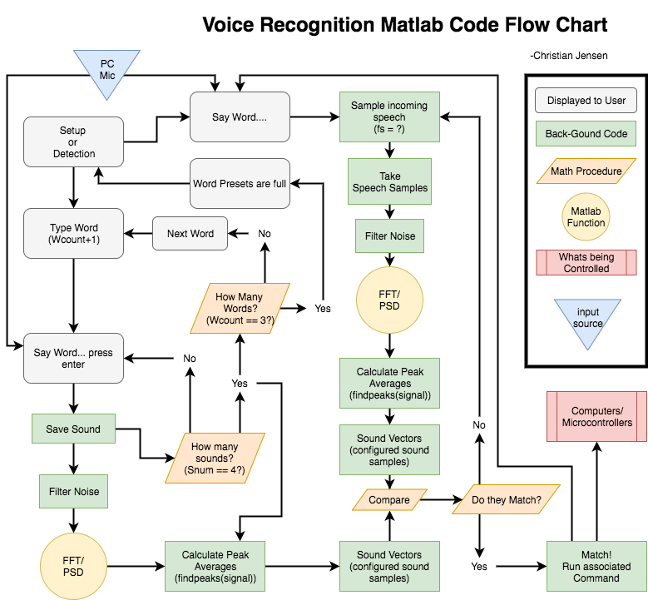

Slide 13
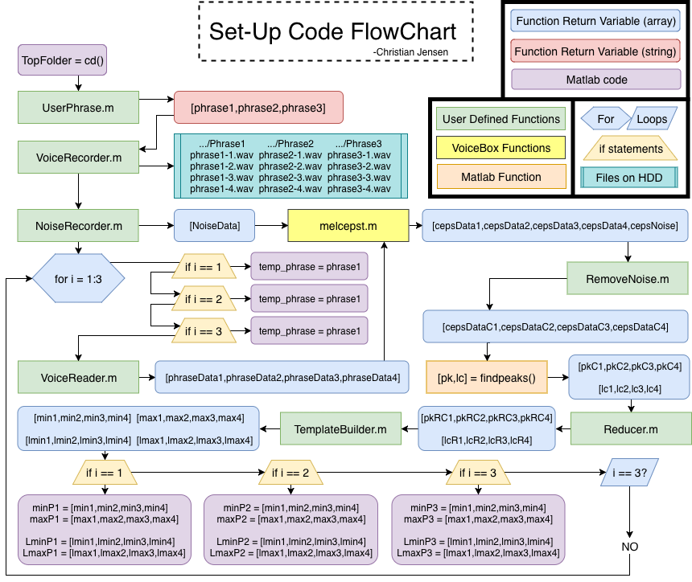

Slide 14
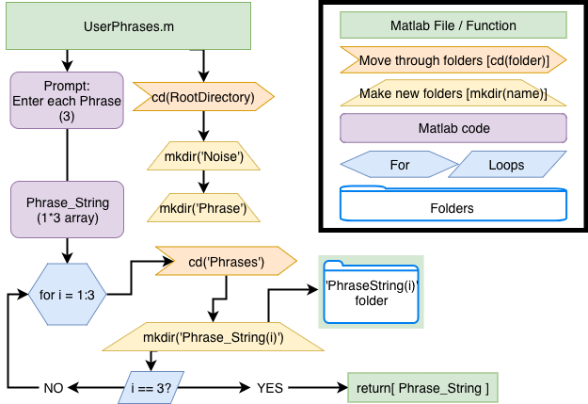

Slide 15
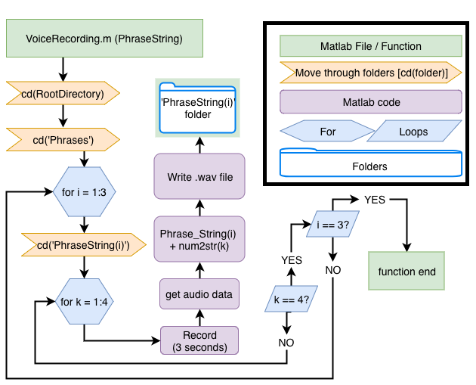

Slide 16
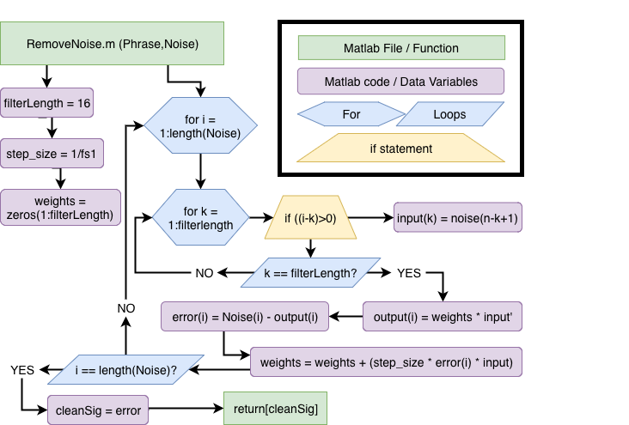
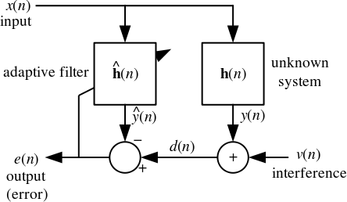
Least Mean Squared adaptive filter

Slide 17
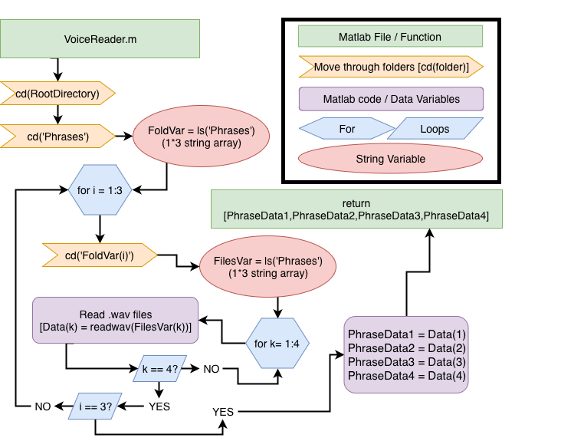

Slide 18

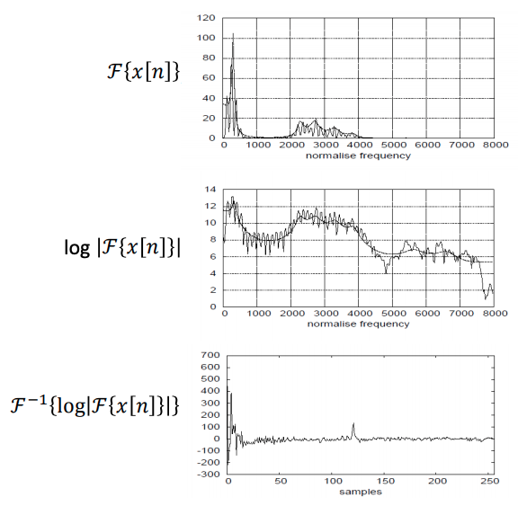
Cepstrum
C[n] = Cepstrum
IDFT of Log-spectrum over time
Inverse of frequency called Quefrecy

Slide 19
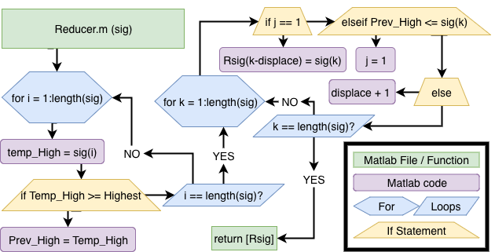
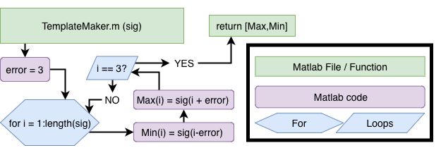

Slide 20
Voice Recognition Methods
Process:
Ask user to set up phrases before
Type name of phrase
Speak the phrase (3x times)
Find the PSD of the signal
Set peaks as template
Speech recognition
Poll for incoming phrases
Sample input
Find the PSD of the signal
Compare peaks with Template
Matlab [7]
Using the computer and its microphone to detect voice
Allows for easier integration with the entire project
Using the Voicebox Toolbox [9]
Contains many voice and audio related functions
*The system will be speaker dependent
(Only recognizing one specific person's commands)

Slide 21
Update on Face Recognition and Hardware
Completed Face Recognition software to detect user successfully. Will be tweaking it more down the road after main goal to open the door is completed.
Currently working on best route to send wireless signal to open the door for the user.
Will be using Zigbee module (ordered through stockroom) to send command to Master Zigbee Module (John's Zigbee), then Master module will send command to MCU to open the door
Researching on methods, which motor to use to open the door.
Will be working on code for Computer to Zigbee communication
Once goal is accomplished, will be working on facial gesture detection to make recognition more secure

Slide 22
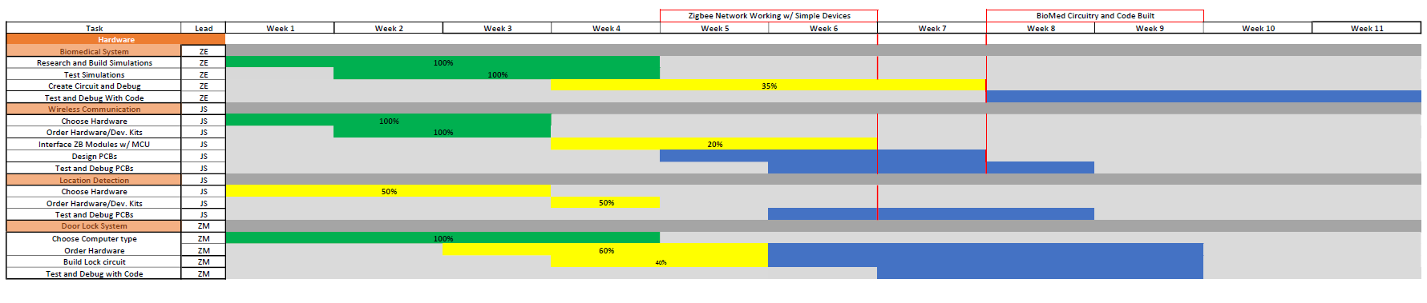
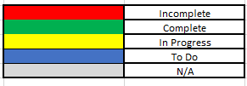
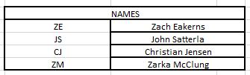
Gantt Chart

Slide 23
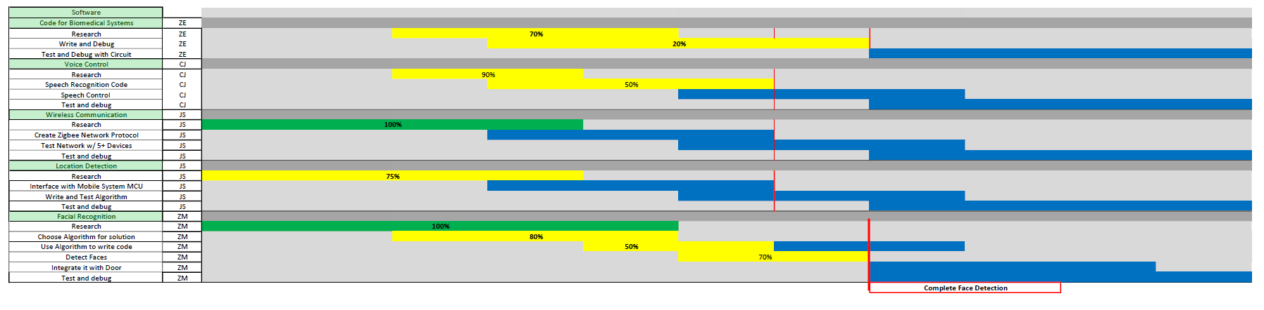
Gantt Chart

Slide 24
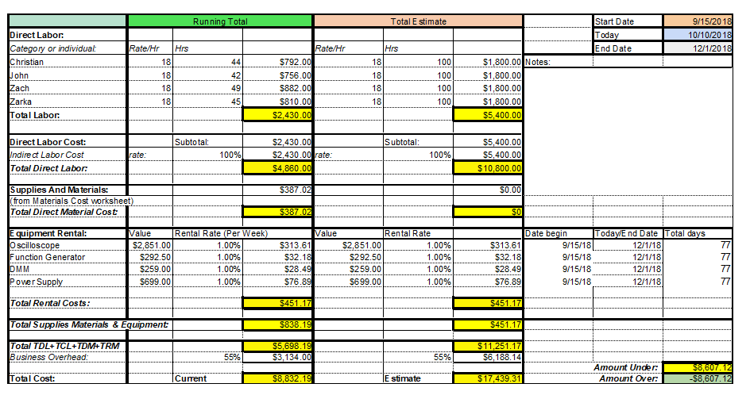
Budget

Slide 25
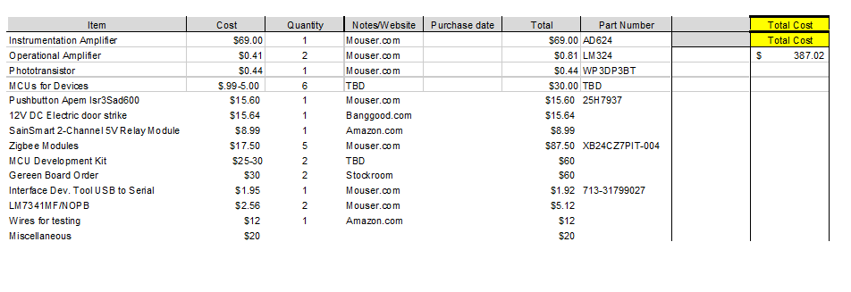
Material Cost

Slide 26
Next Week's Deliverables
John Satterla
Zachary Eakerns
Zarka McClung
Christian Jensen
Test ToF further with optimizations
Send meaningful data over Zigbee network for logging of health data
Start developing GUI for system monitoring and control
Have Python communication with MCU ready for testing
Hardware research
Select method to open door
Order some parts to begin testing
Start sampling input words to find what fs to use
Continue writing Matlab code
Research Matlab controlling MCUs through computer

Slide 27
References
“RN-42 Data Sheet.” [Online]. Available: https://cdn.sparkfun.com/datasheets/Wireless/Bluetooth/Bluetooth-RN-42-DS.pdf. [Accessed: 23-Oct-2018].
“Time Of Flight (TOF) Initiator,” TI Cloud Tools, 2018. [Online]. Available: http://dev.ti.com/tirex/#/?link=Software/SimpleLink CC2640R2 SDK/Examples/Development Tools/CC2640R2 LaunchPad/blestack/tof_initiator. [Accessed: 24-Oct-2018].

Slide 28
Questions?

